Slide 1


Assessment 2B- 2019 EDU2CAA
CURRICULUM AND ASSESSMENT
Notes:
IMPROVING STUDENT PERFORMANCE THROUGH BUILDING INSTRUCTIONAL CAPACITY-Elmore, Fullan et al
Chart paper, blu-tac and markers as needed.
Links to PAT videos
Print off the pages refer1red to slide 7 or use links as listed on the slide

Slide 2
Part B
Provided here is one set of data for everyone to use (primary or secondary focus).
We justify this wide focus by reminding you all that the principles and purpose of effective assessment are and should be the same for F-10.
Notes:
If we had separated the data into two distinct areas we were concerned that you might consider there to be a separation of primary and secondary assessment strategies, with different principles or purpose. That outcome is not the case.

Slide 3
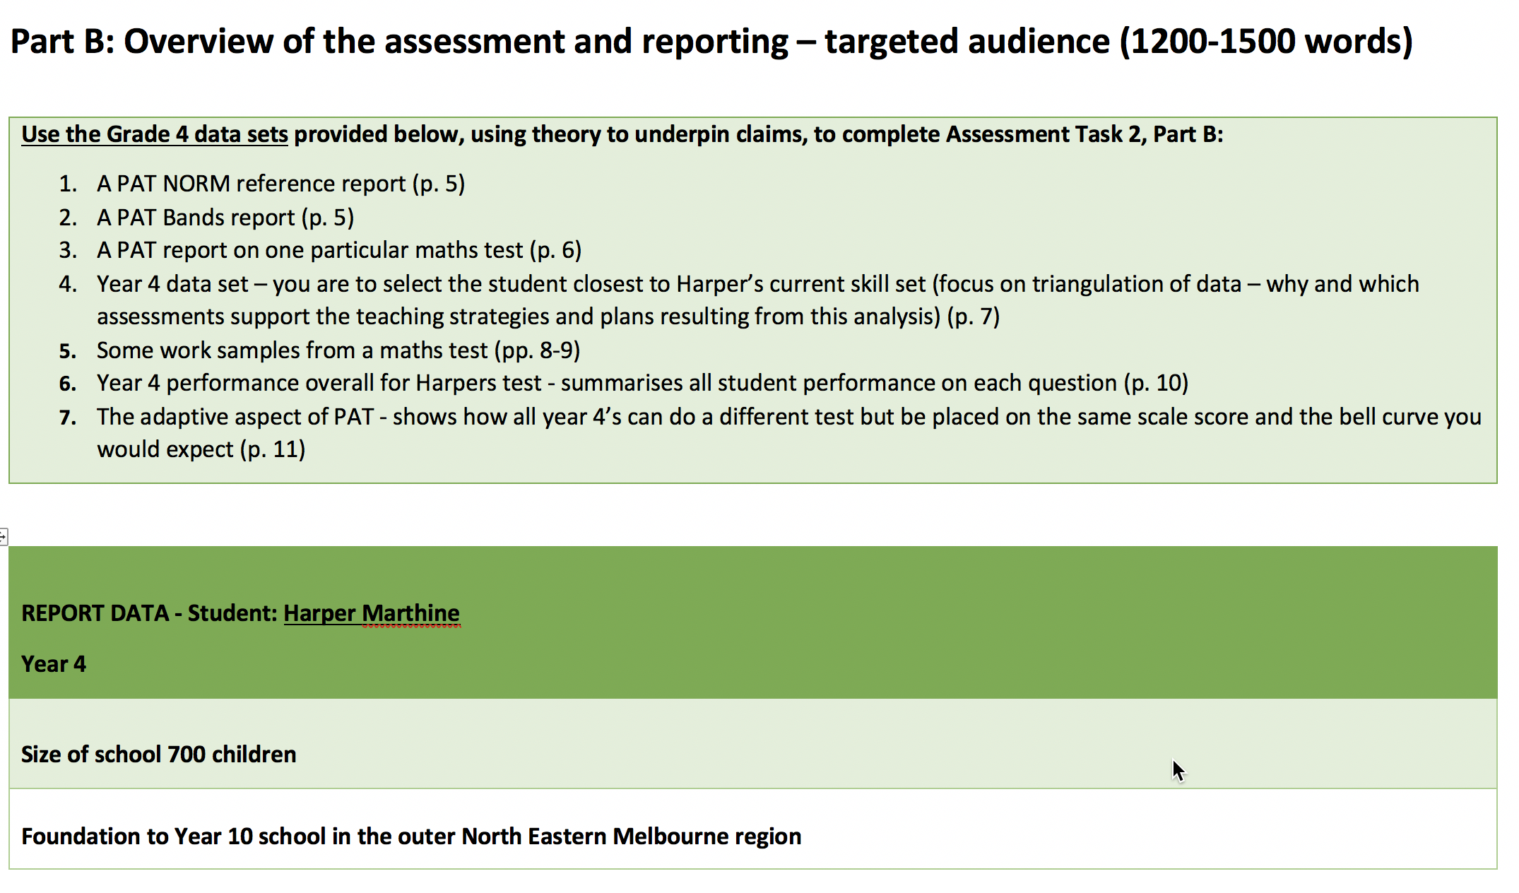
Notes:
Here we again indicate the amount of work we are expecting around 1500 words, or 2/3 of your assessment.
We have listed all the information provided
USE THE ELEMENTS OF INFORMATION YOU NEED TO BEST TELL YOUR STORY.
To triangulate you need at least three sources for each claim.
You might for example use three of the data sets provided to address one point one, two or three more to substantiate a different claim.
The next section, starting with the darker green box sets a scenario,

Slide 4
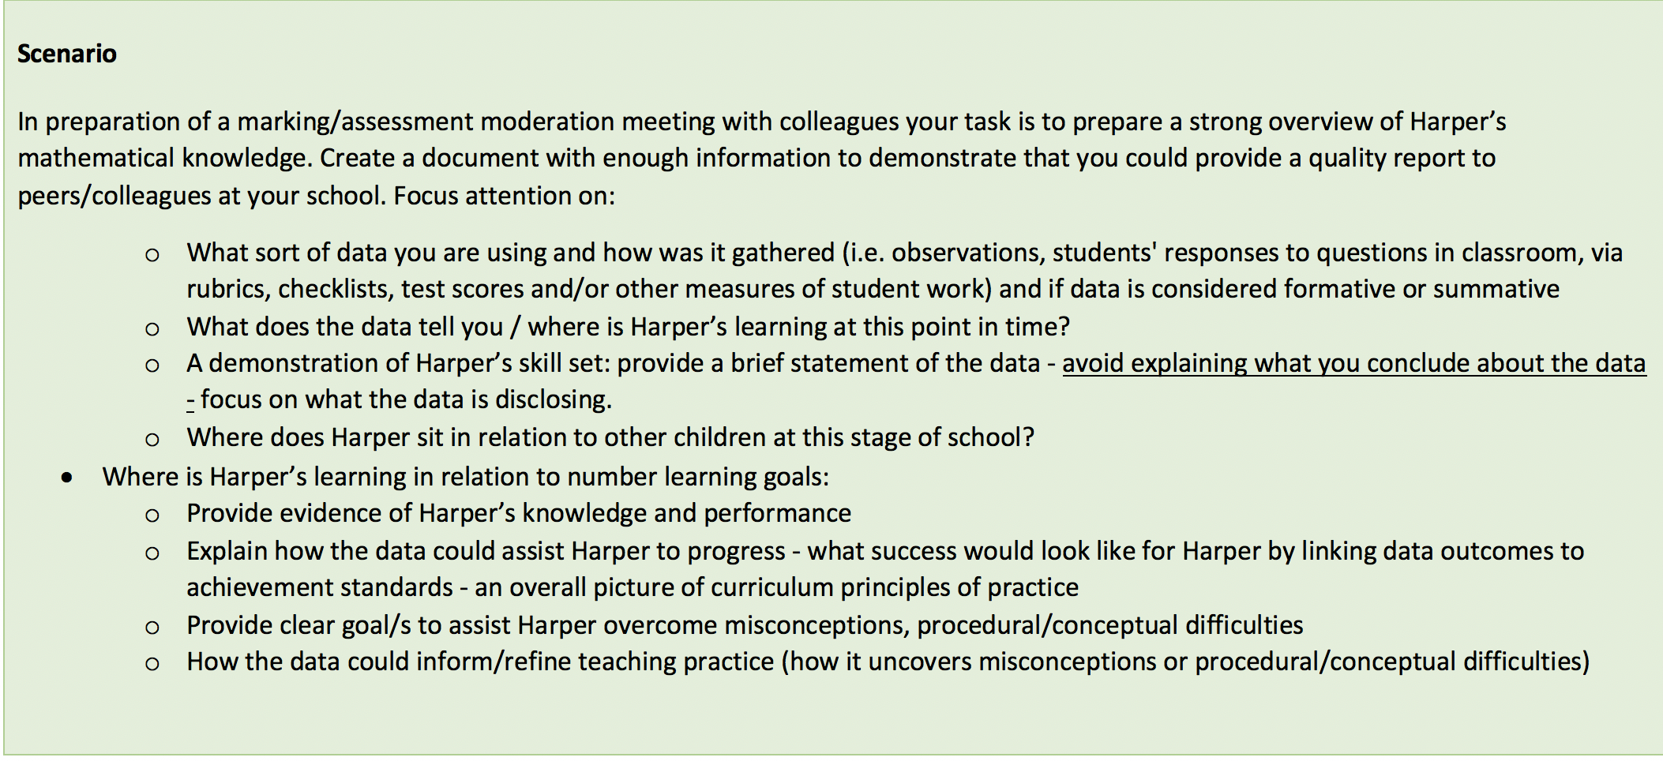
The task: Part B
Notes:
And here is the task.
What sort of data are you using: well here you do not have access to observations…. What do you have access to?
What does the data tell you?
Write a brief statement of the data set
Where is Harper’s learning in relation to number learning goals
Establish the learning goals and connect direct references from the data provided on how you made that assertion.
From the data say what you would do to progress Harper’s learning
Noting clear PoPs connections
Provide clear examples of how to assist Harper to learn (as noted in above points) and overcome misconceptions/conceptual difficulties

Slide 5
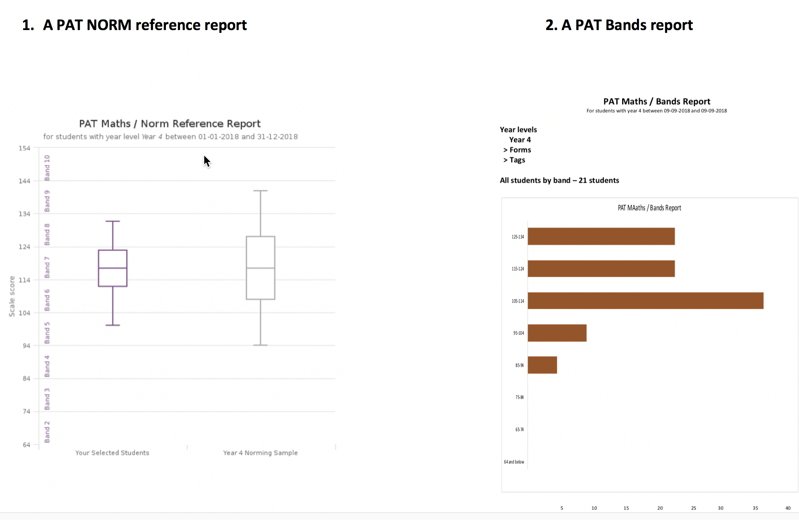
What do you have here?
NOTE: Box and whisker plots examined in detail Lecture week 7
Notes:
What information are you able to gather here.
Last week we looked at how to unpack a box and whisker plot a bands report
Share with others what you would be able to write about.

Slide 6
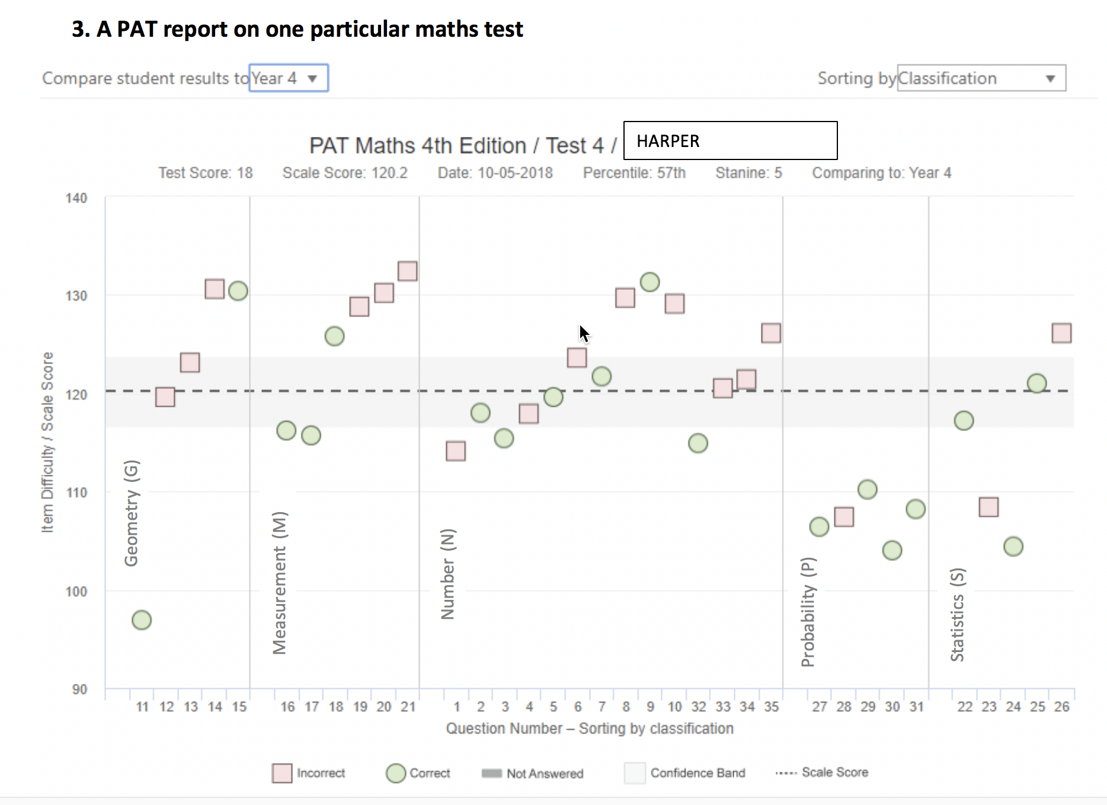
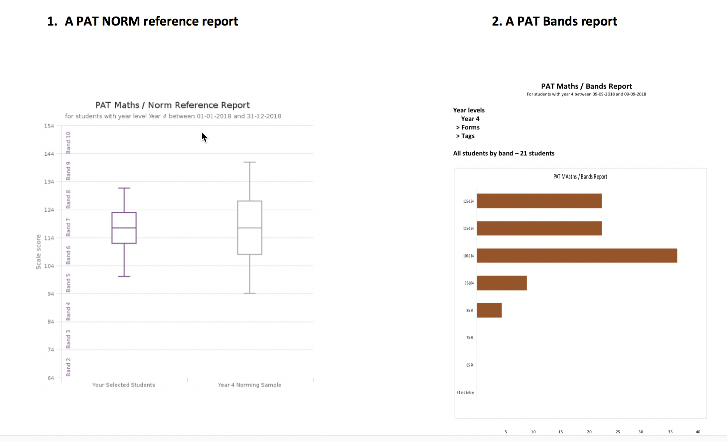
Notes:
You know how to read this data
Online LMS in the assessment tile you will see the appropriate Levels
Share with others what you would be able to write about.

Slide 7
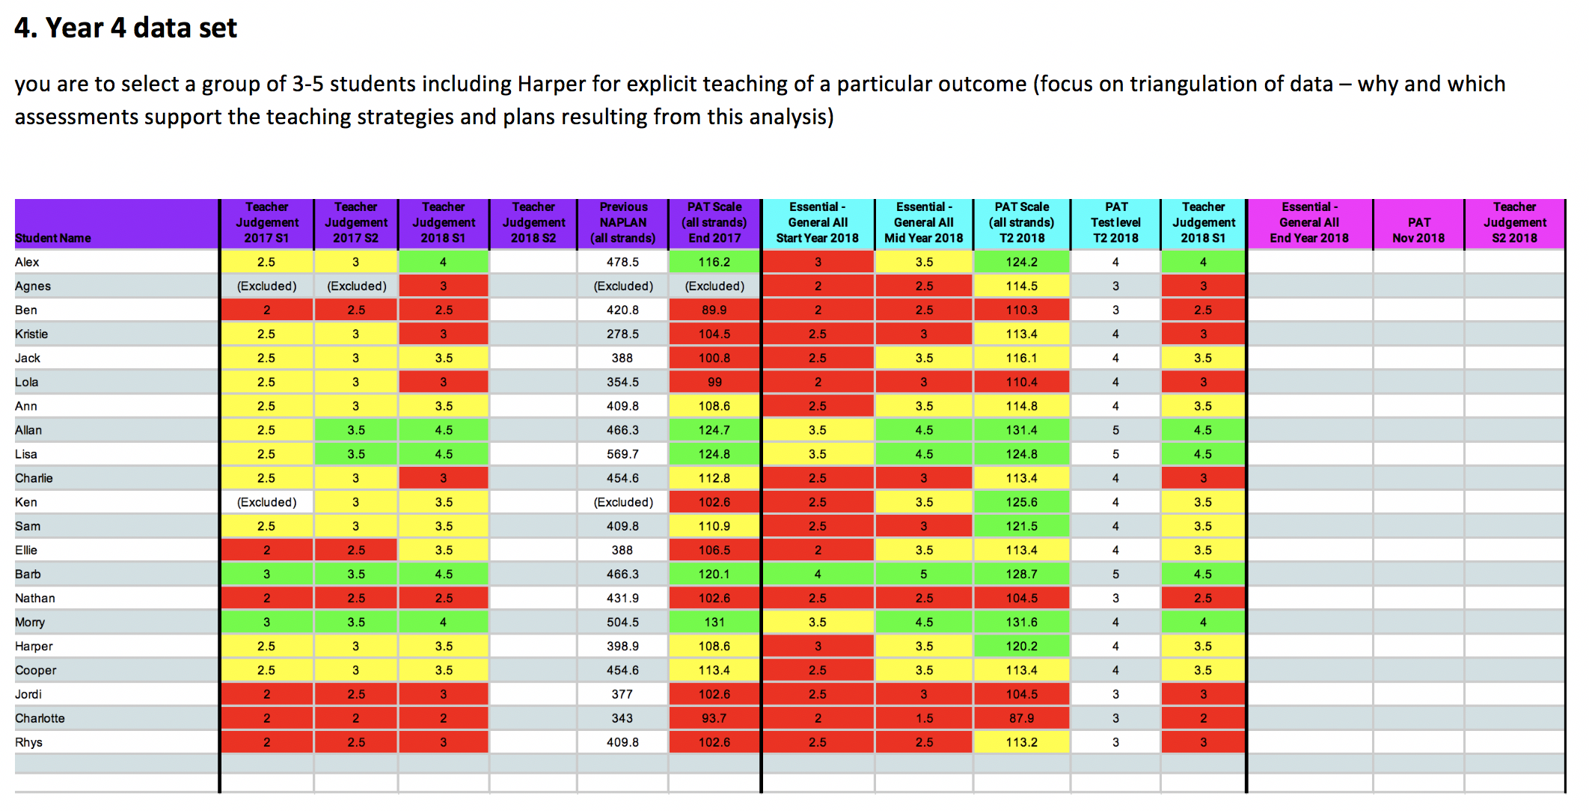
What does this table tell you?
Notes:
Here we can triangulate to NAPLAN
Share with others what you would be able to write about.

Slide 8
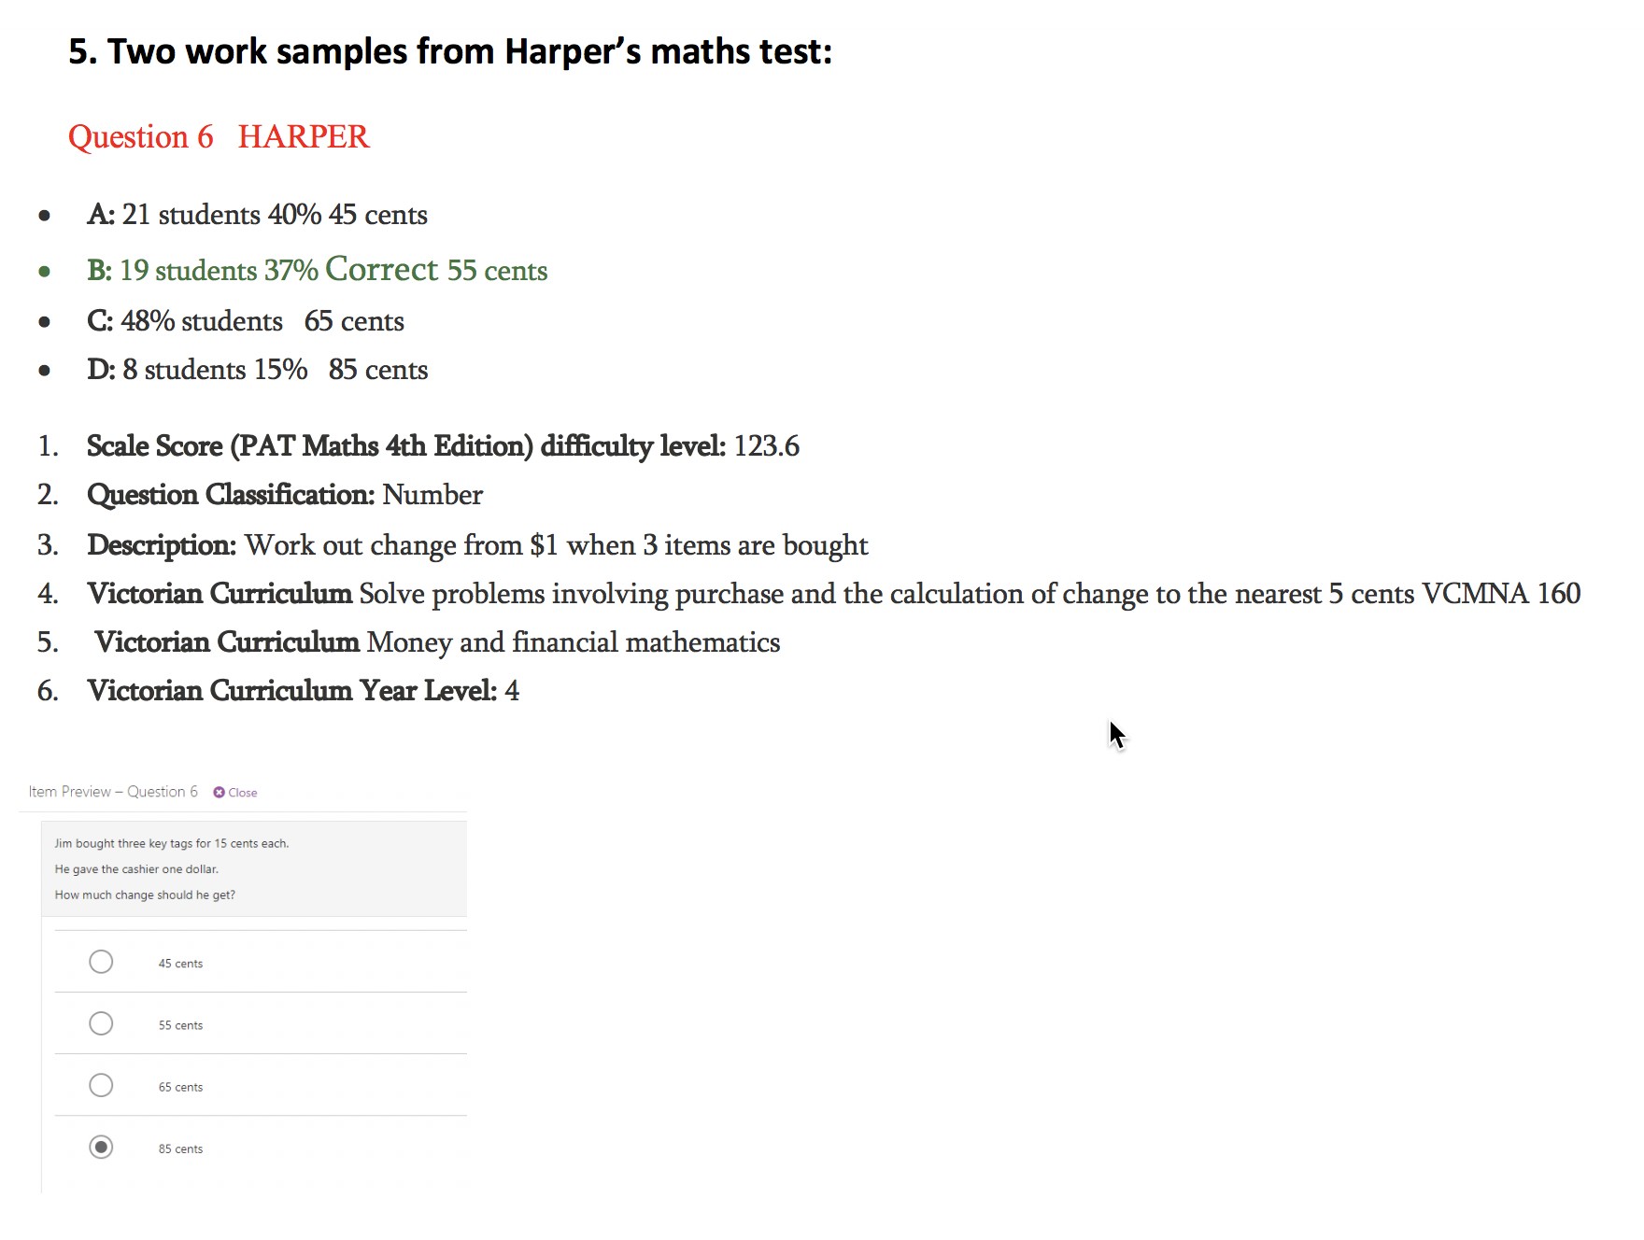
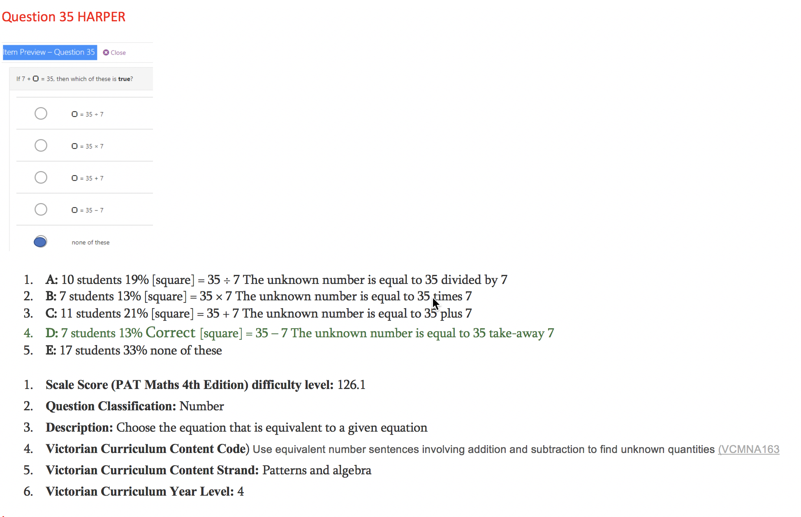
We know you can read this!
Notes:
We have looked at examples like these before in class what do they tell you?
PAT score level
Question classification – Number
What are the question numbers?
Where it fits in regard to Vic Curriculum and the Vic Curriculum level
Share with others what you would be able to write about.

Slide 9
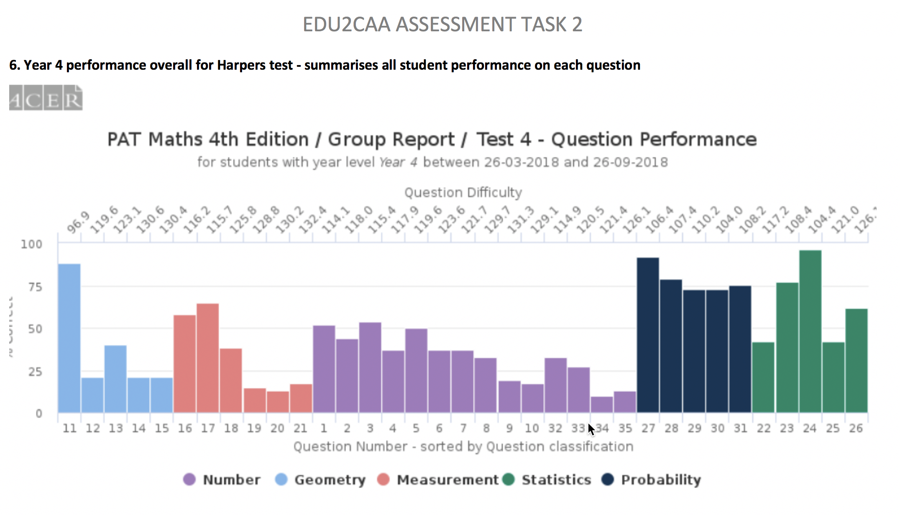
Notes:
What does it tell you?
Well you need to focus on the question classification – Number
What particular questions did you have to look at?
What can you now say about those questions in relation to other students in the class?
Share with others what you would be able to write about.

Slide 10
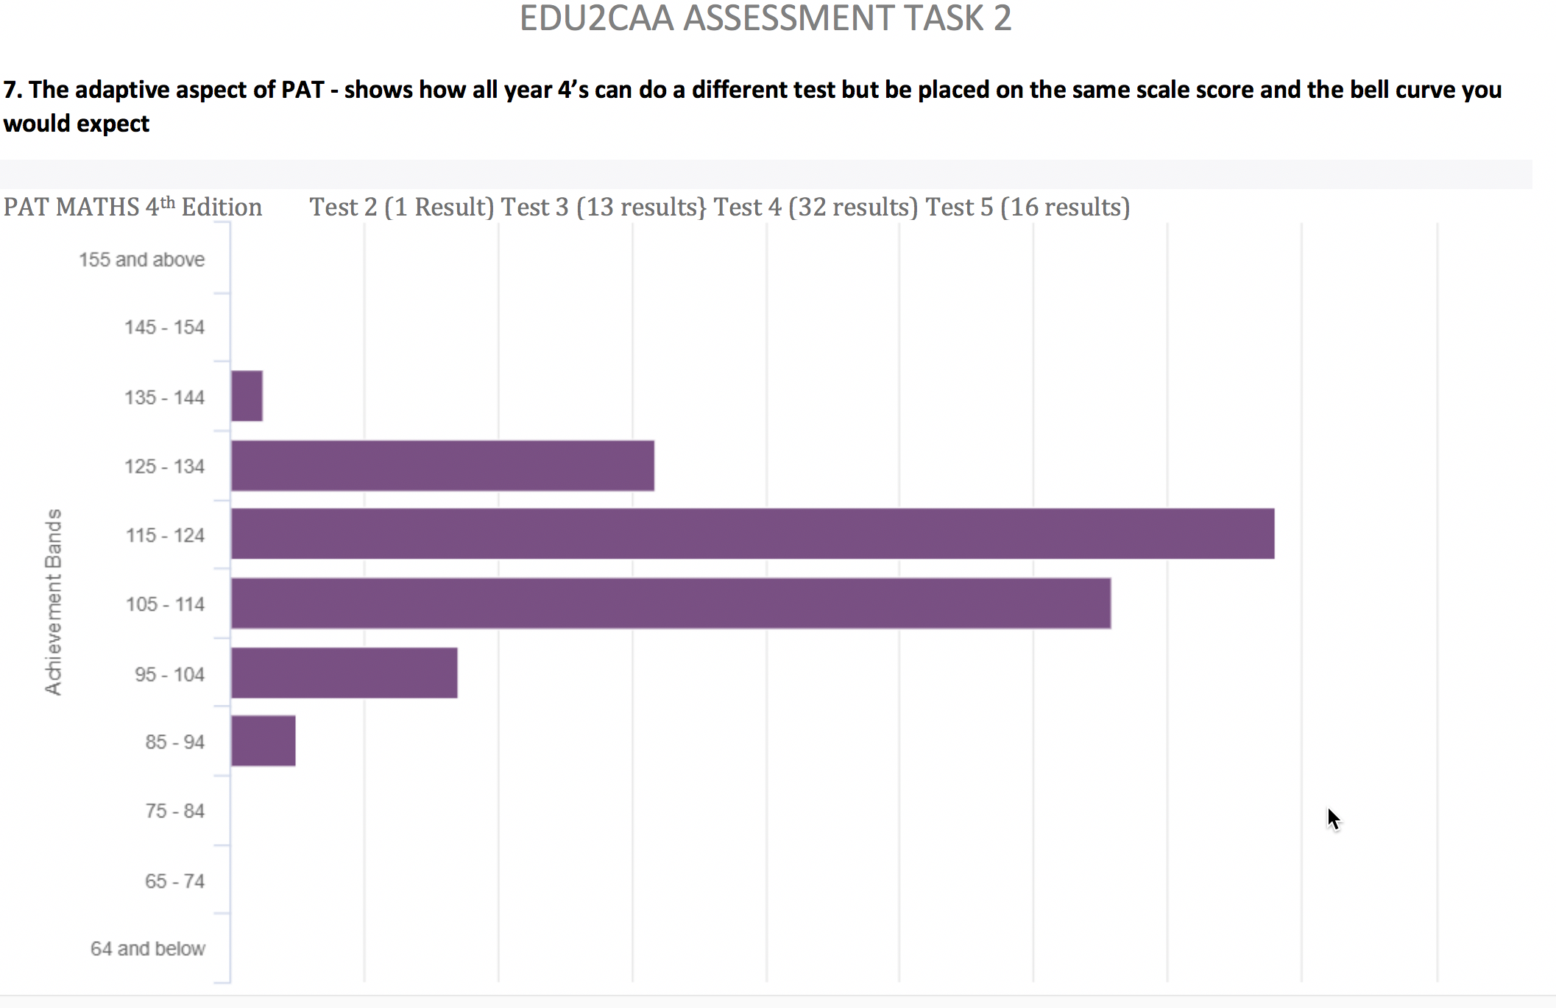
Notes:
What are you getting from this?
Can you see the achievement band that Harper is in and how it fits with this graph?
Share with others what you would be able to write about.

Slide 11

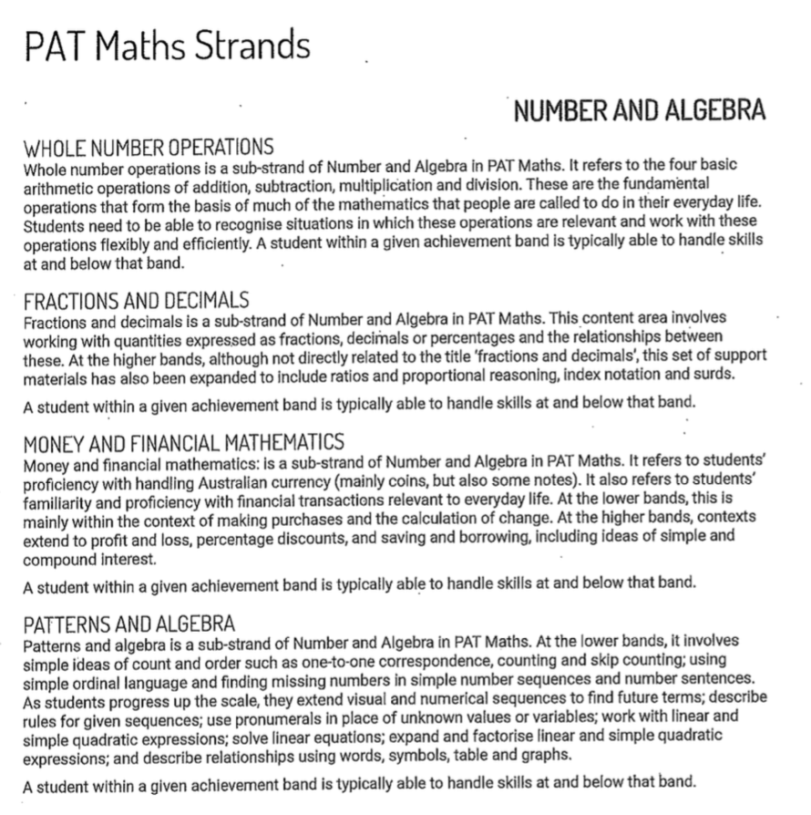
Notes:
How does this information assist?
You will need to decide on the appropriate PATs achievement levels from the levels provided here and on the following slides.

Slide 12
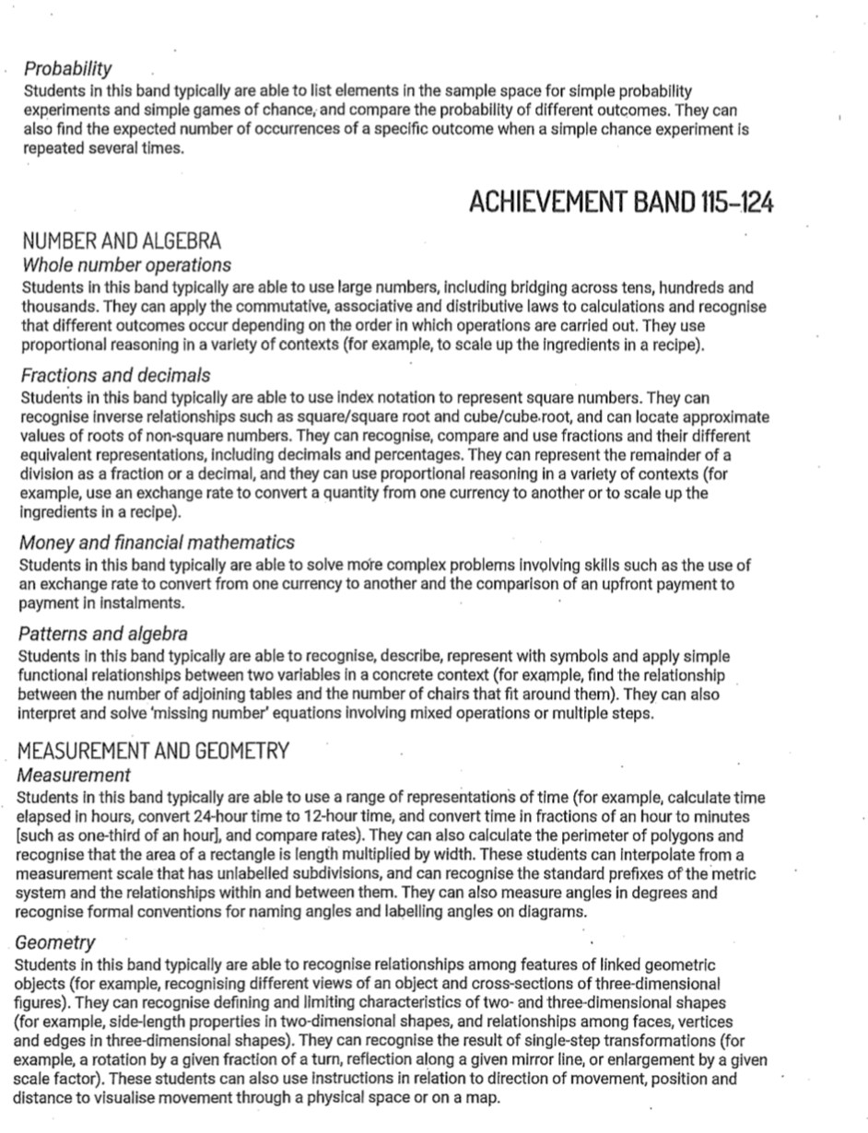
Notes:
What information are you able to gather from this information?
You will need to decide on the appropriate PATs achievement levels from the levels provided here and on the following slides.

Slide 13
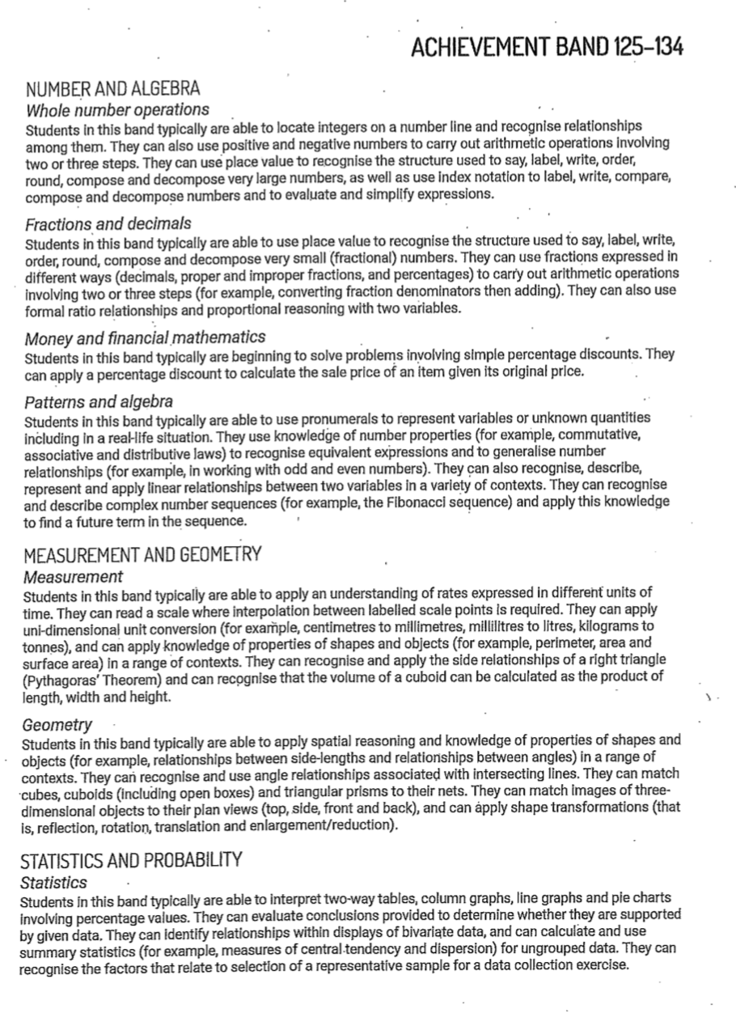
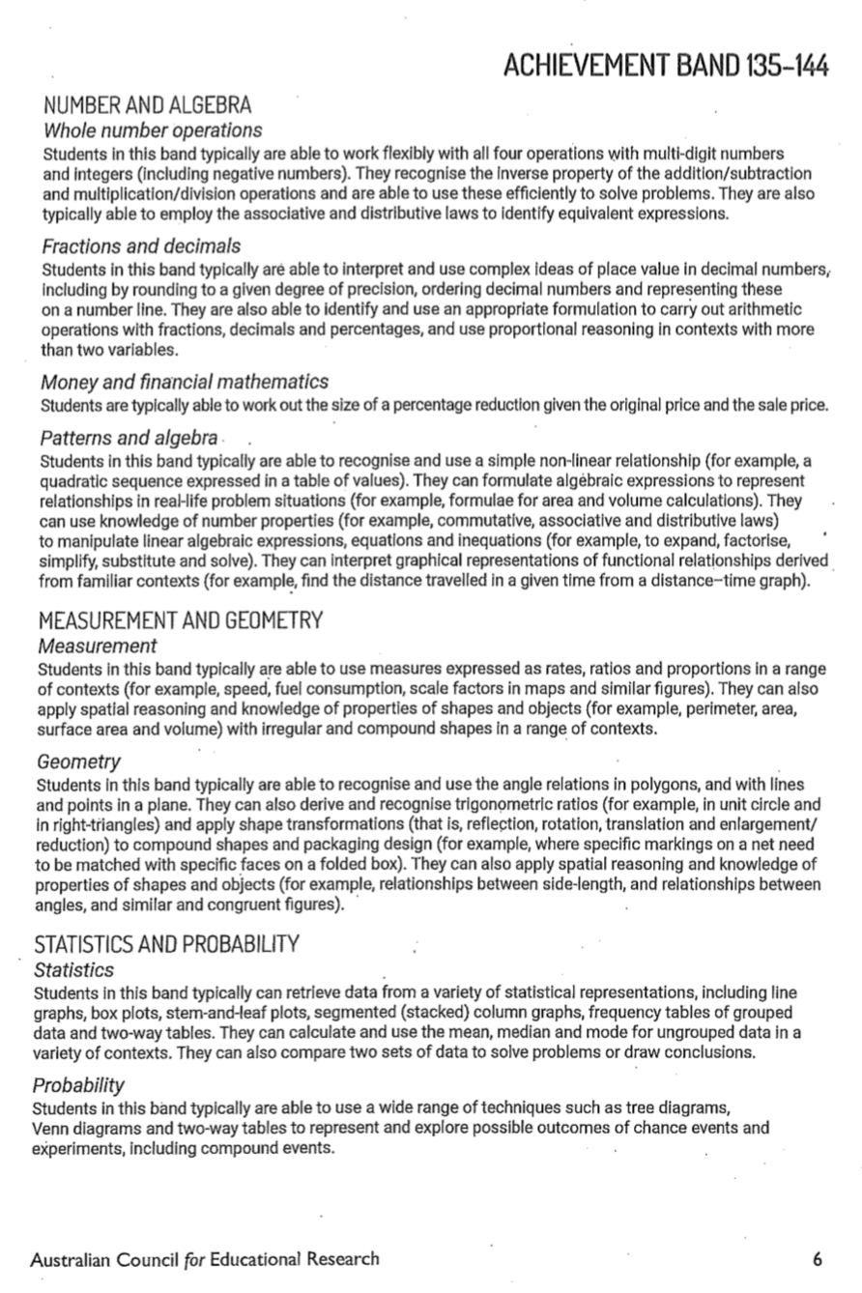
Notes:
What information are you able to gather from this information?
You will need to decide on the appropriate PATs achievement levels from the levels provided here and from previous slides.

Slide 14
Biggest hint ever:
Make sure you self assess by aligning your work with the assessment criteria

